Slide 1


Spring 2021
SKKU Biostats and Big data
CHOONG-WAN WOO | COCOAN lab | http://cocoanlab.github.io

Slide 2
GBME Probability and Statistics
Lecture 12
Lecture 12
Probability models
CHOONG-WAN WOO | COCOAN lab | http://cocoanlab.github.io

Slide 3
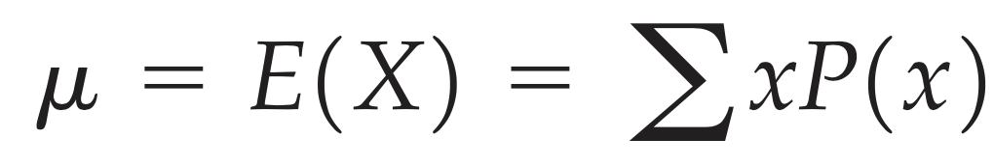
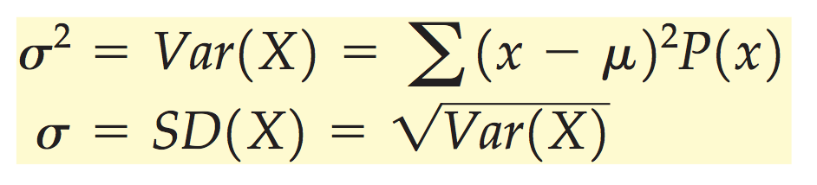
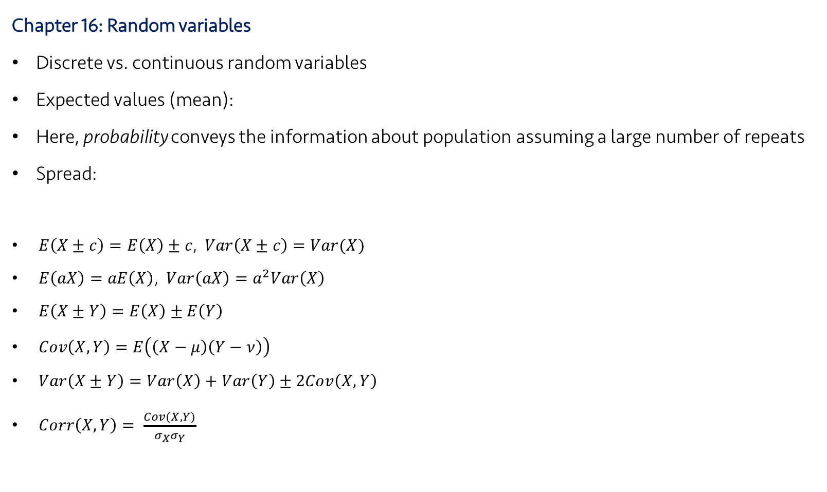
Lecture 12
Review: Key Points
Chapter 16: Random variables
Discrete vs. continuous random variables
Expected values (mean):
Here, probability conveys the information about population assuming a large number of repeats
Spread:
$E\left(X±c\right)=E\left(X\right)±c$, $Var\left(X±c\right)=Var(X)$
$E\left(aX\right)=aE\left(X\right)$, $Var\left(aX\right)=a^{2}Var\left(X\right)$
$E\left(X±Y\right)=E\left(X\right)±E\left(Y\right)$
$Cov\left(X,Y\right)=E\left(\left(X−μ\right)\left(Y−ν\right)\right)$
$Var\left(X±Y\right)=Var\left(X\right)+Var\left(Y\right)±2Cov\left(X,Y\right)$
$Corr\left(X,Y\right)= \frac{Cov(X,Y)}{σ_{X}σ_{Y}}$
CHOONG-WAN WOO | COCOAN lab | http://cocoanlab.github.io

Slide 4
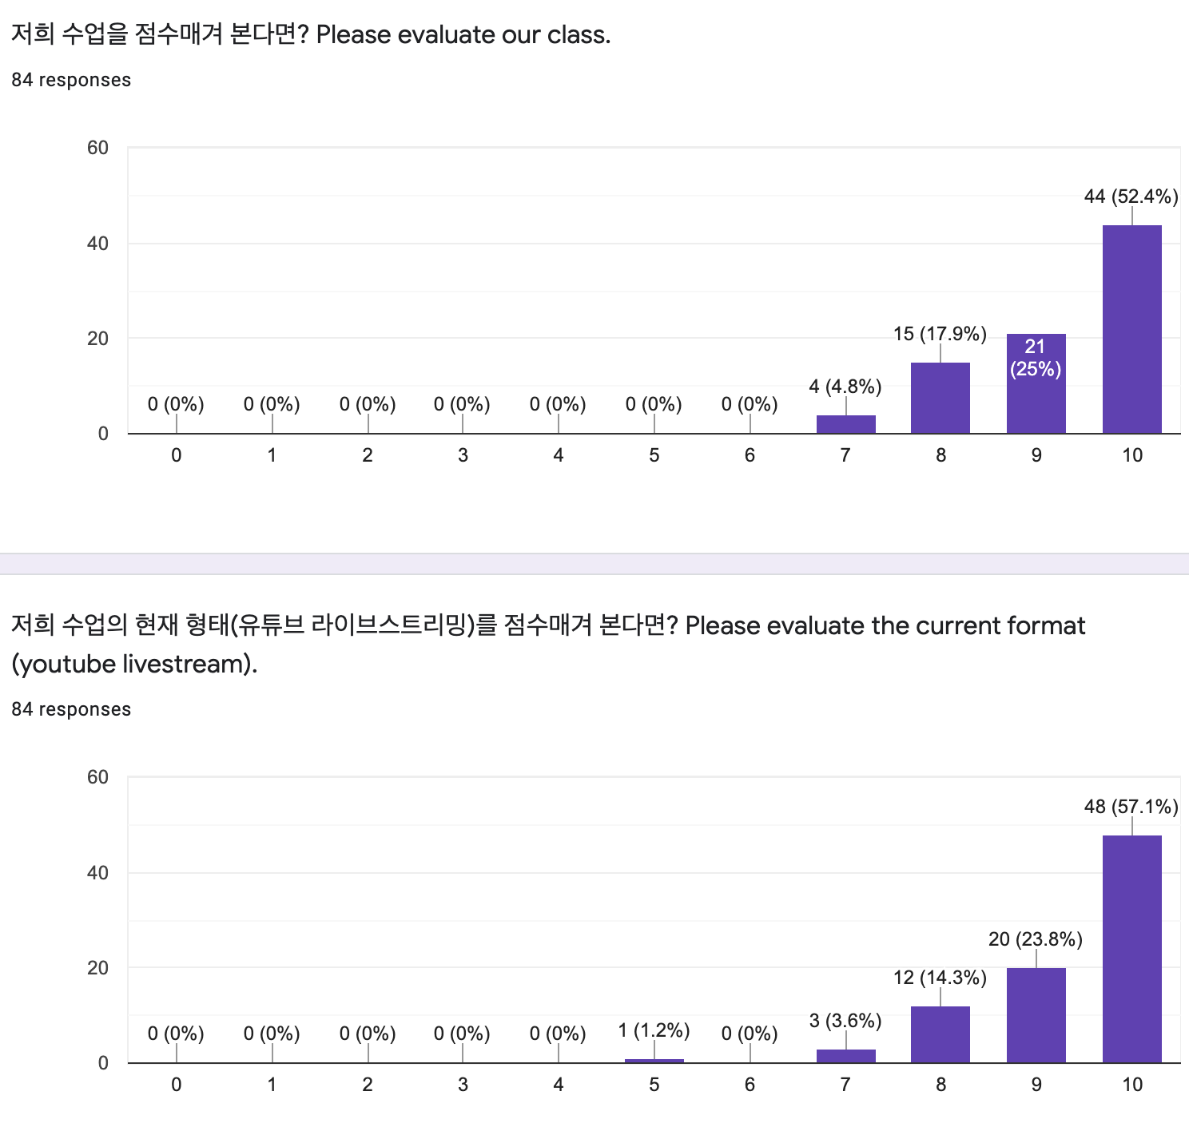
Lecture 12
Interim survey results
Let’s see the feedback together. ☺
CHOONG-WAN WOO | COCOAN lab | http://cocoanlab.github.io

Slide 5
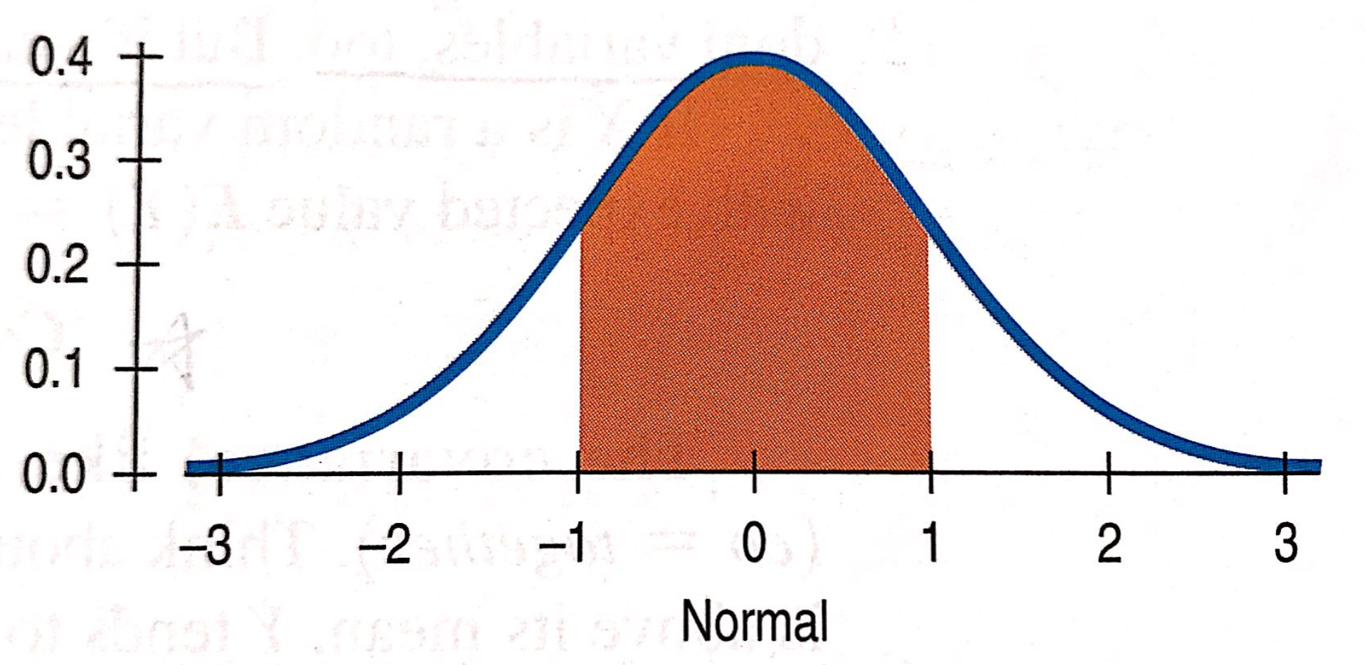
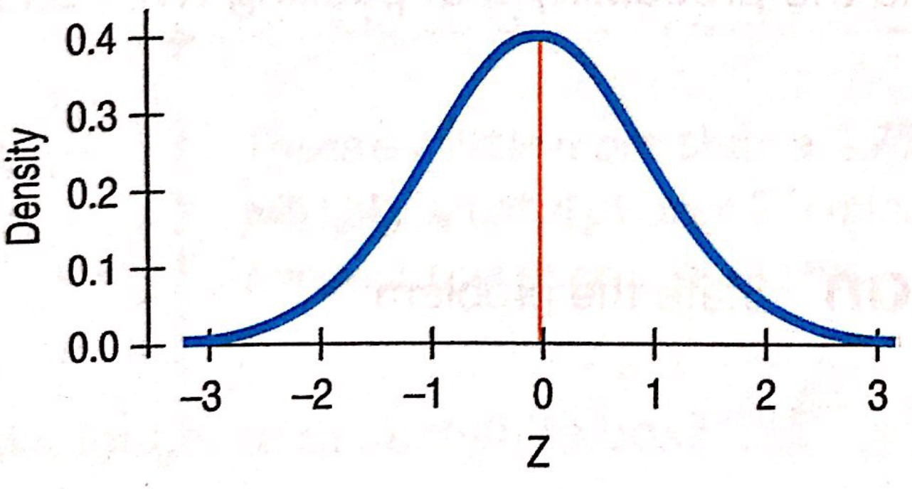
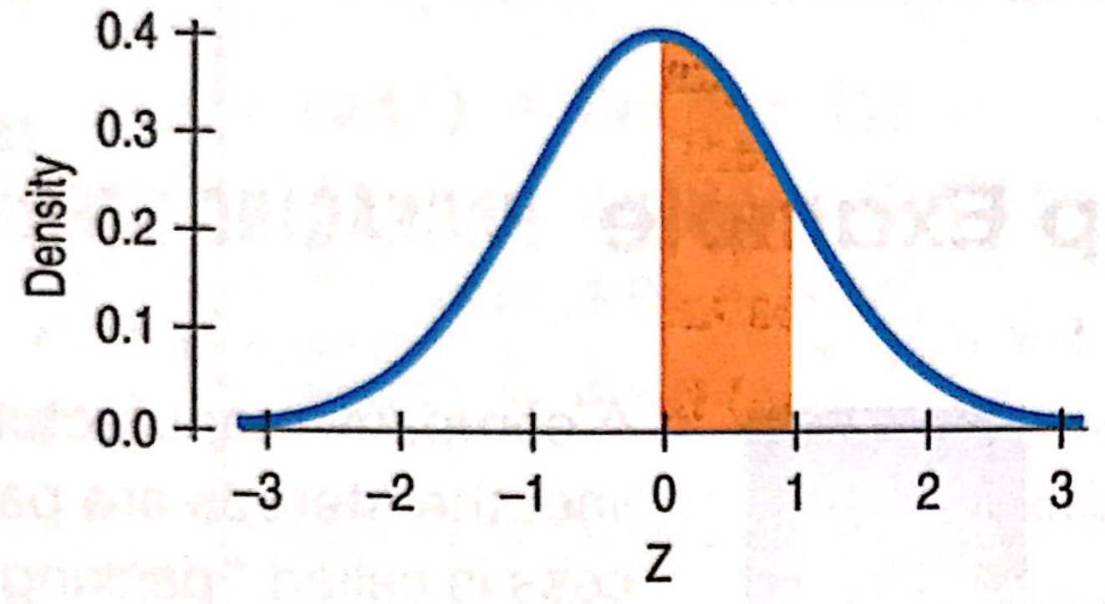
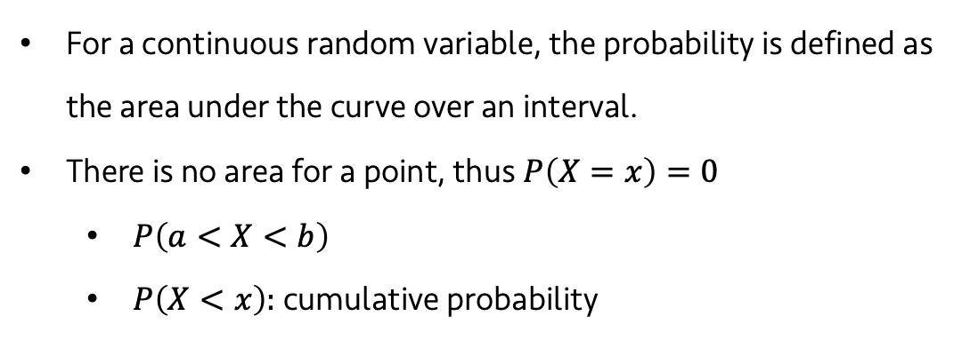
Lecture 12
Probability models for continuous random variables
For a continuous random variable, the probability is defined as the area under the curve over an interval.
There is no area for a point, thus $P\left(X=x\right)=0$
$P\left(a<X<b\right)$
$P\left(X<x\right)$: cumulative probability
CHOONG-WAN WOO | COCOAN lab | http://cocoanlab.github.io

Slide 6
Lecture 12
Quiz 12-1 (3 min)
https://forms.gle/LaprTCB2jGXJRvaH7
CHOONG-WAN WOO | COCOAN lab | http://cocoanlab.github.io

Slide 7
Lecture 12
Multiple probability models for random variables
Normal model is just one model among many.
In this chapter, we will go over the following models:
Geometric model
Binomial model
Poisson model
Uniform model
Exponential models
CHOONG-WAN WOO | COCOAN lab | http://cocoanlab.github.io

Slide 8
Lecture 12
Bernoulli Trials
Success
Failure
In a snack box:
Success rate = 10%, the probability of success, p = 0.10
Two possible outcomes (success vs. failure)
Trials (purchasing snack boxes) are independent
Other Bernoulli trials: tossing a coin, shooting free throws, etc.
10%
40%
50%
CHOONG-WAN WOO | COCOAN lab | http://cocoanlab.github.io

Slide 9
Lecture 12
Quiz 12-2 (2 min)
https://forms.gle/Ds1NyGm67KK8RFod9
CHOONG-WAN WOO | COCOAN lab | http://cocoanlab.github.io

Slide 10
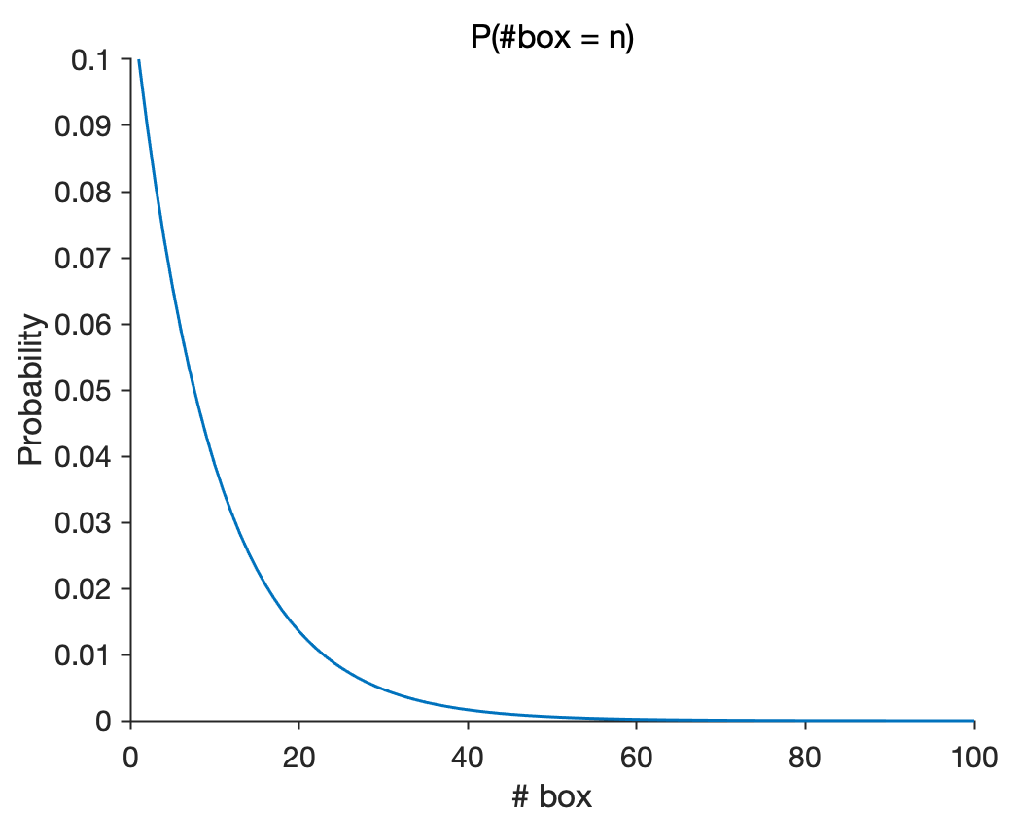
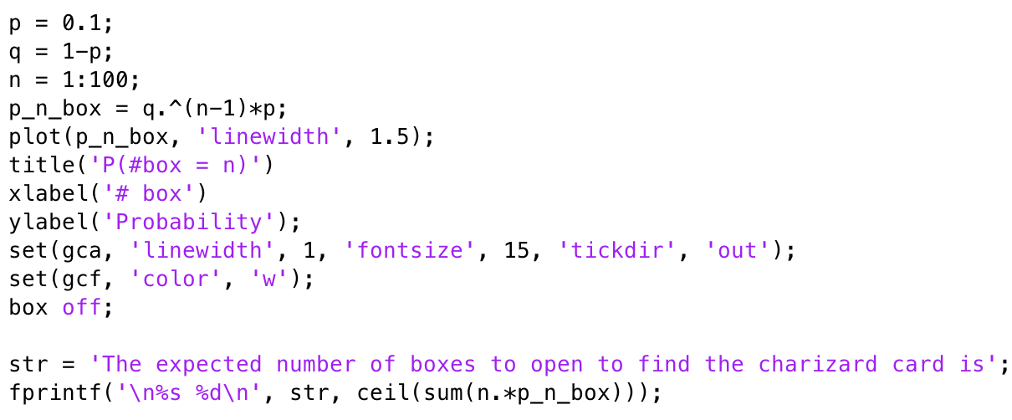
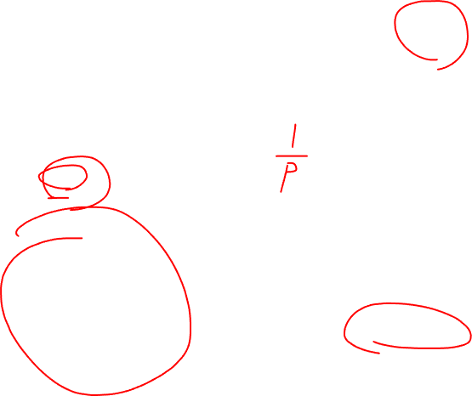
Lecture 12
Geometric (등비, 等比) model
“How many snack boxes we will need to open to find the card?”
P(#box=1) = 0.1
P(#box=2) = (0.9) x (0.1)
… P(#box = 5) = (0.9)⁴ x (0.1)
E(#box) = 10 = 1/0.1
CHOONG-WAN WOO | COCOAN lab | http://cocoanlab.github.io

Slide 11
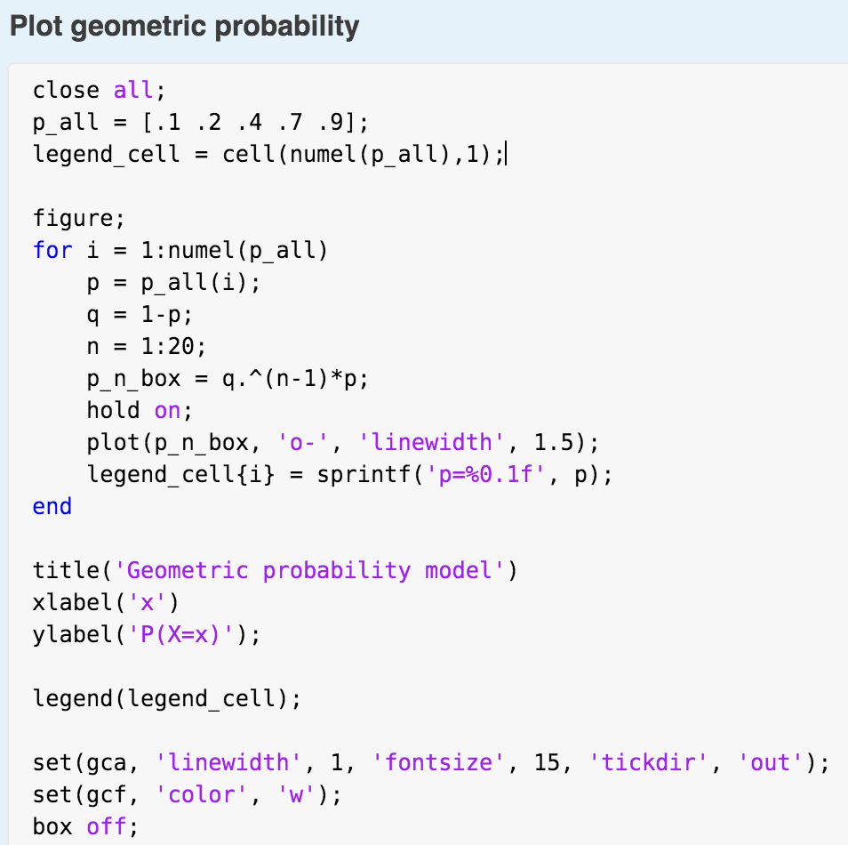
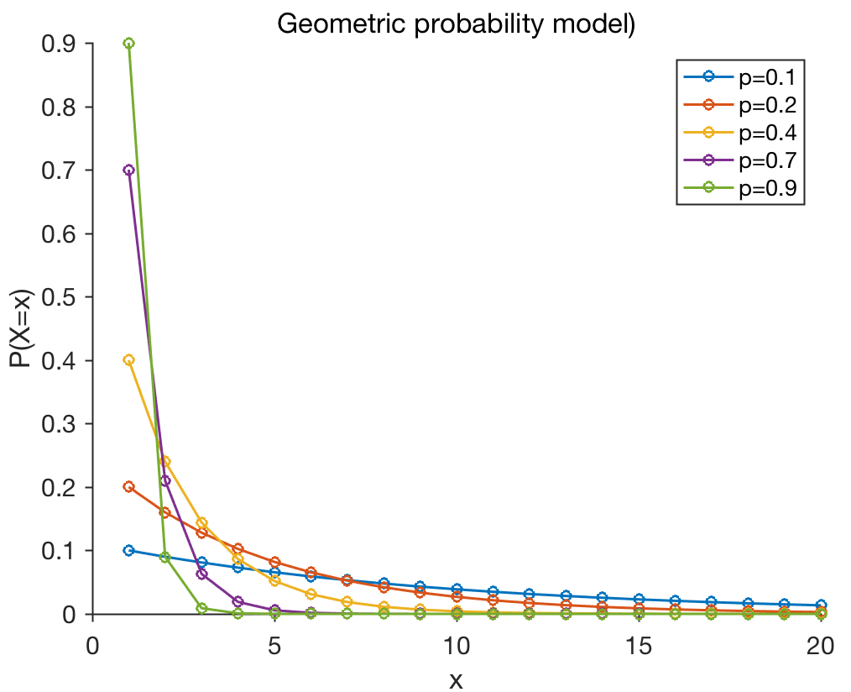
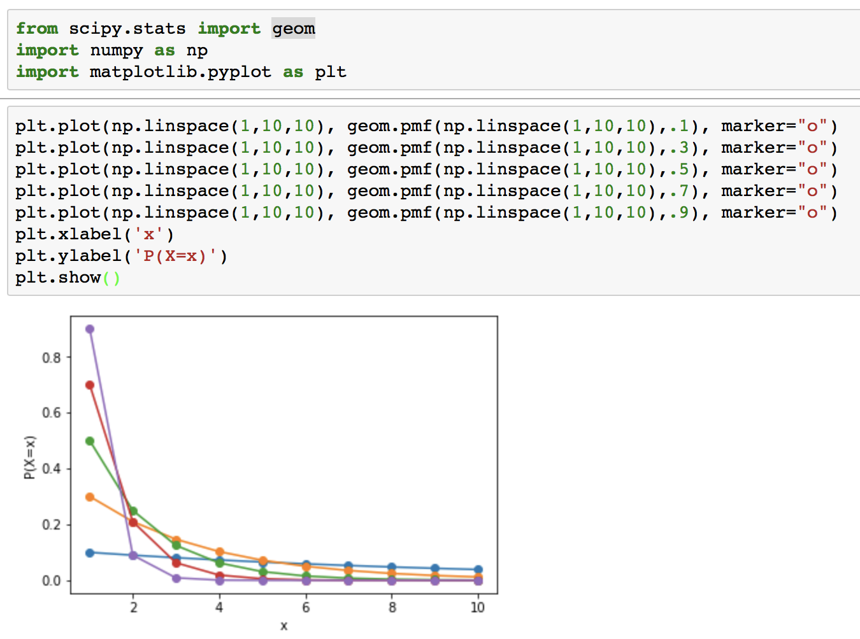
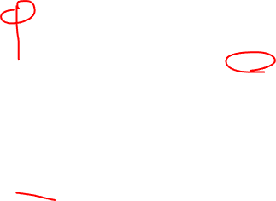
Lecture 12
Geometric model
Geometric probability model, Geom(p)
CHOONG-WAN WOO | COCOAN lab | http://cocoanlab.github.io
Python example

Slide 12
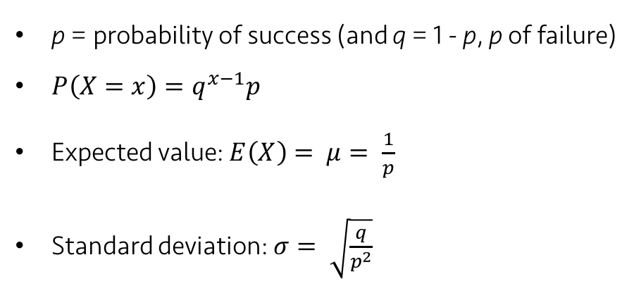
Lecture 12
Geometric model
Geometric probability model, Geom(p)
p = probability of success (and q = 1 - p, p of failure)
$P\left(X=x\right)=q^{x−1}p$
Expected value: $E\left(X\right)= μ= \frac{1}{p}$
Standard deviation: $σ= \sqrt{\frac{q}{p^{2}}}$
CHOONG-WAN WOO | COCOAN lab | http://cocoanlab.github.io

Slide 13
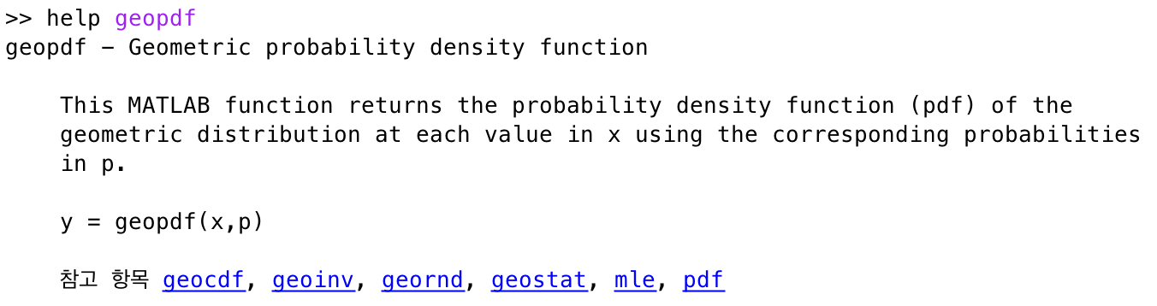
Lecture 12
Geometric model
geopdf.m and geocdf.m in MATLAB
geom.pmf, cdf, etc. in Scipy (Python)
CHOONG-WAN WOO | COCOAN lab | http://cocoanlab.github.io

Slide 14
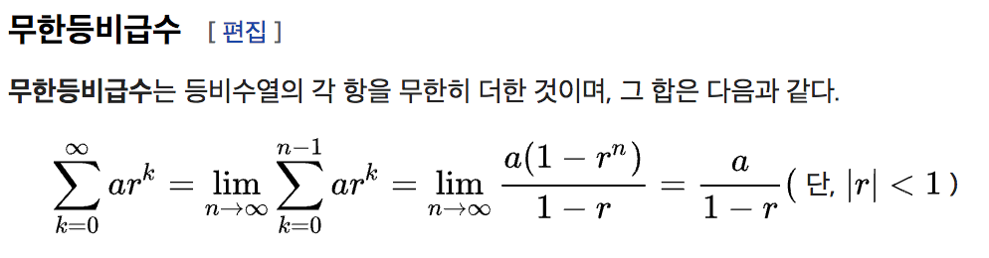
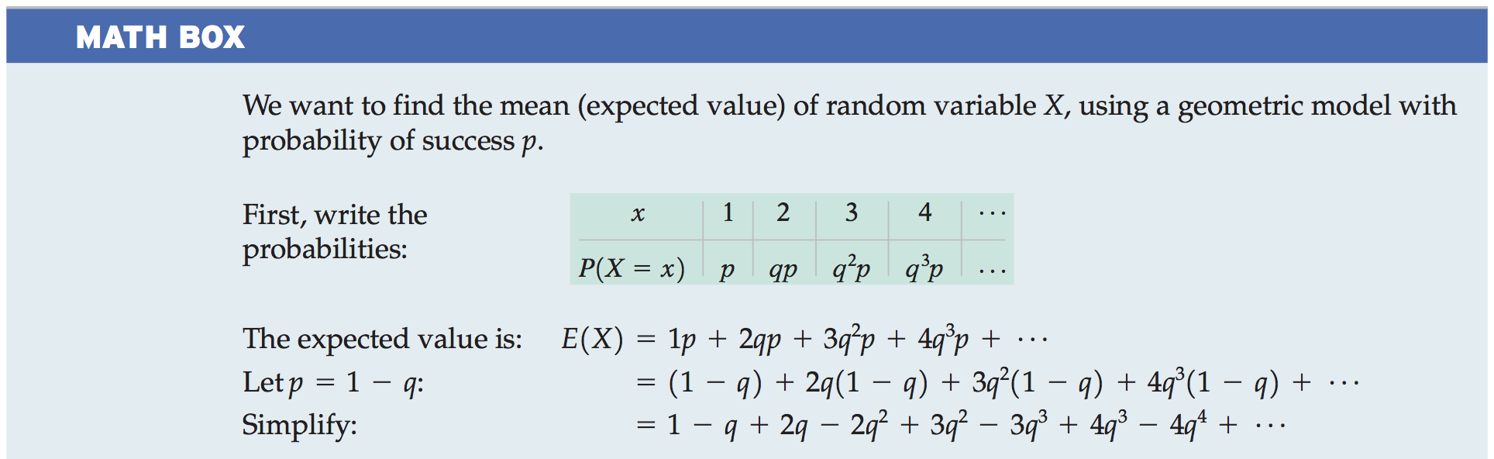
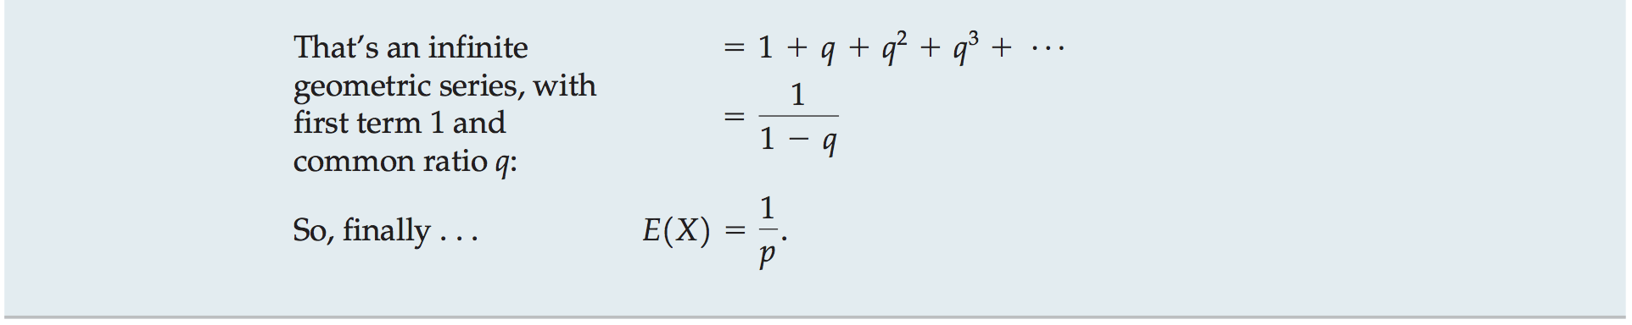

Lecture 12
Geometric model
참고:
Geometric probability model
CHOONG-WAN WOO | COCOAN lab | http://cocoanlab.github.io

Slide 15
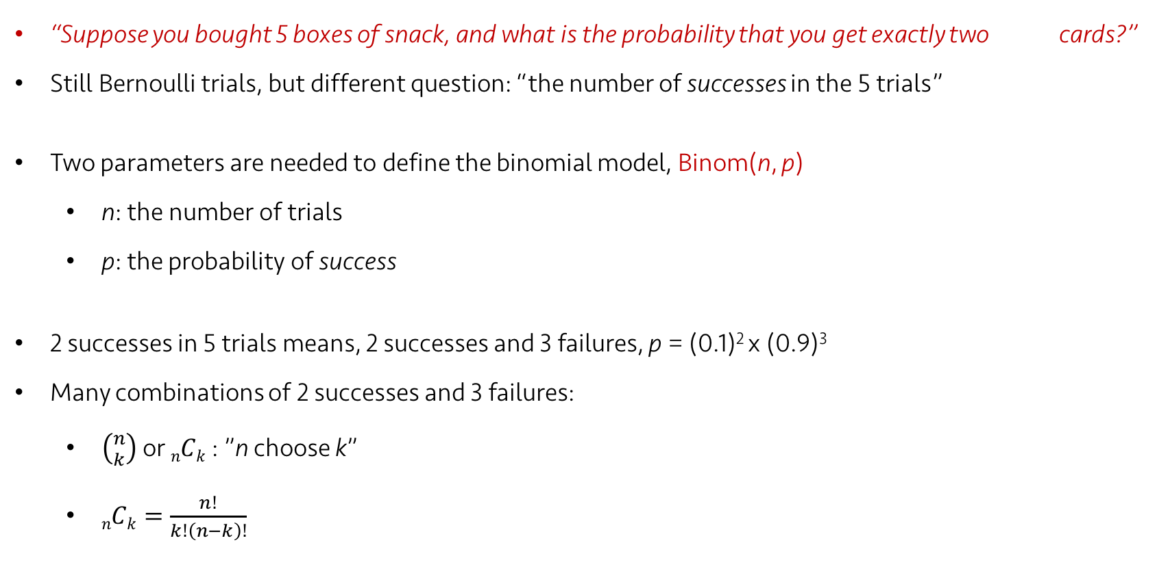
Lecture 12
Binomial model
“Suppose you bought 5 boxes of snack, and what is the probability that you get exactly two cards?”
Still Bernoulli trials, but different question: “the number of successes in the 5 trials”
Two parameters are needed to define the binomial model, Binom(n, p)
n: the number of trials
p: the probability of success
2 successes in 5 trials means, 2 successes and 3 failures, p = (0.1)² x (0.9)³
Many combinations of 2 successes and 3 failures:
$\left({n \atop k}\right)$ or $nCk$ : ”n choose k”
$nCk=\frac{n!}{k!\left(n−k\right)!}$
CHOONG-WAN WOO | COCOAN lab | http://cocoanlab.github.io

Slide 16
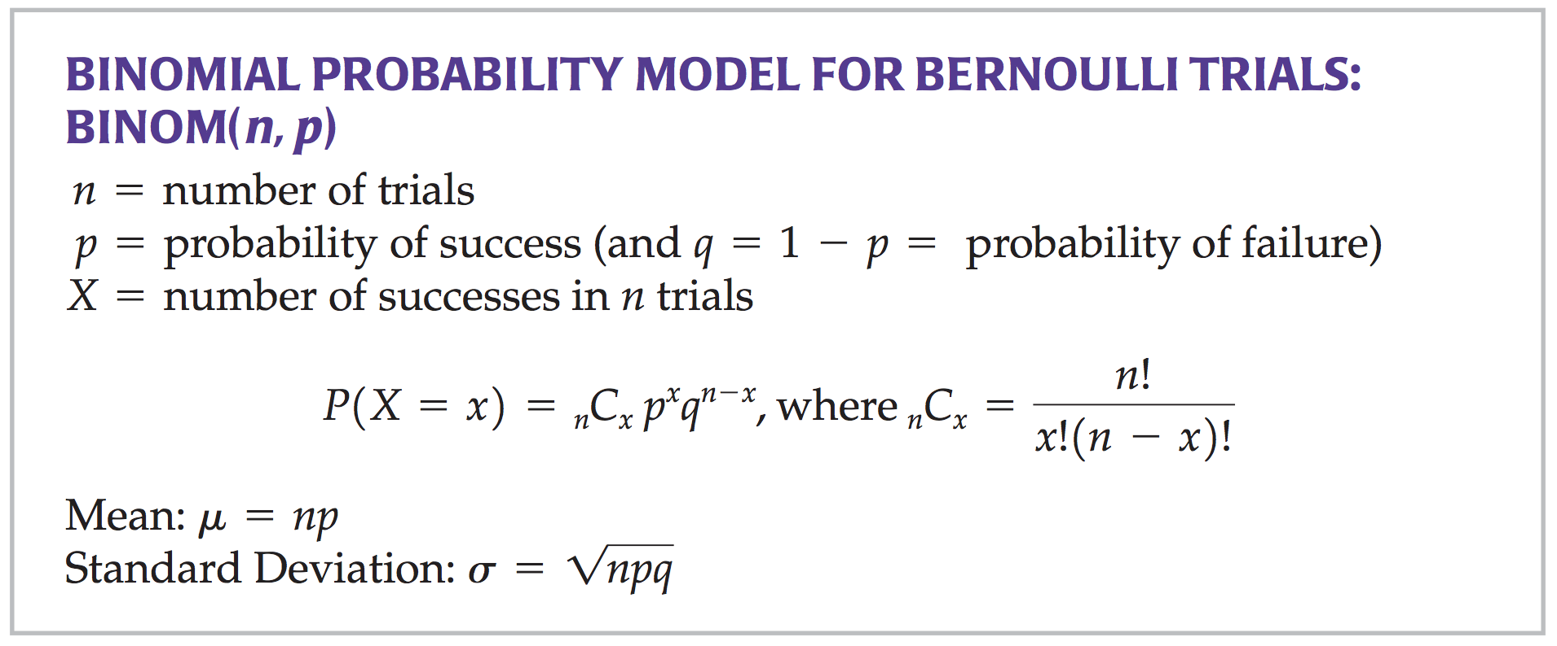
Lecture 12
Binomial model
“Suppose you bought 5 boxes of snack, and what is the probability that you get exactly two cards?”
P(#success = 2) = 10 x (0.1)² x (0.9)³ = 0.0729
CHOONG-WAN WOO | COCOAN lab | http://cocoanlab.github.io

Slide 17
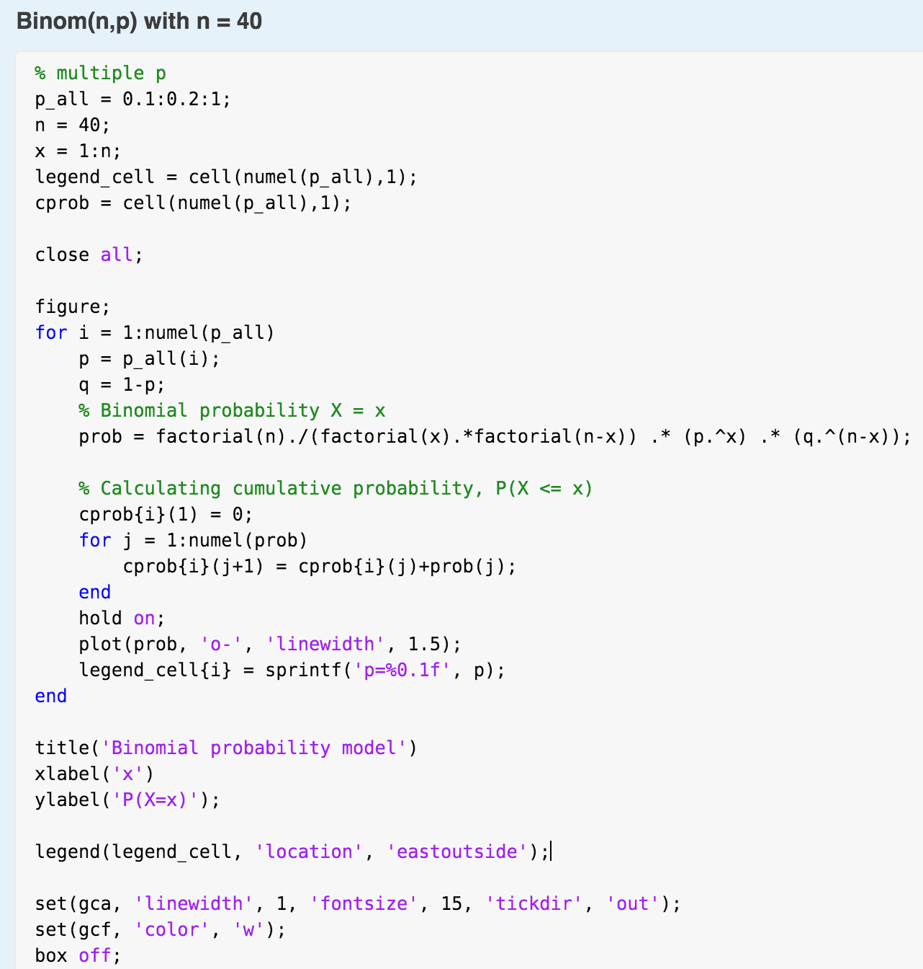
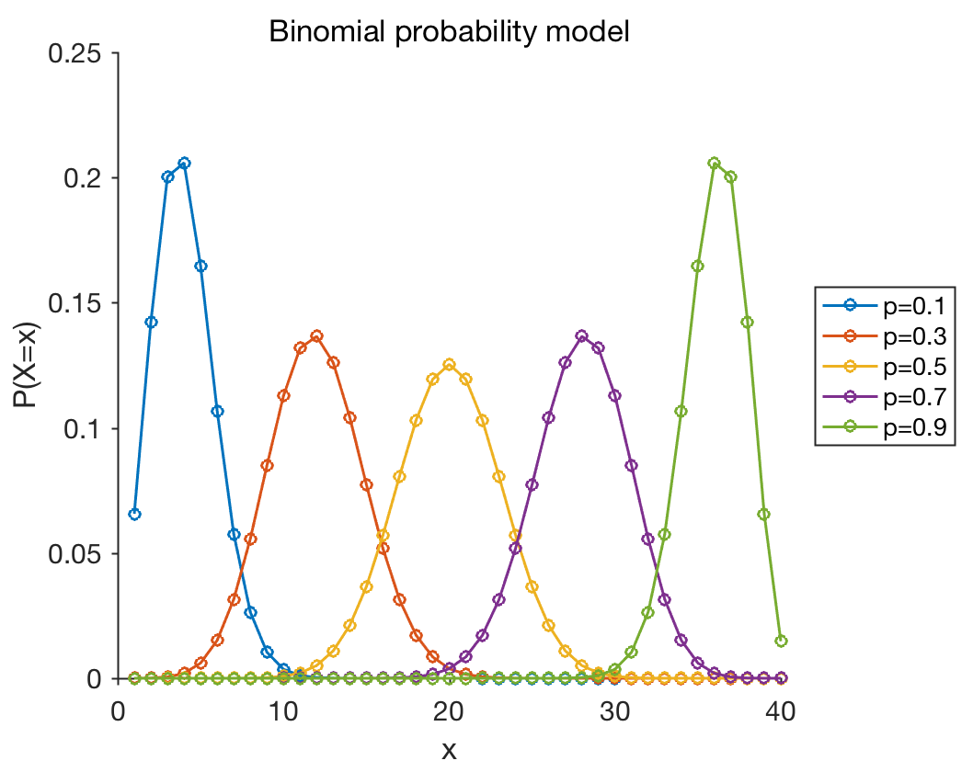
Lecture 12
Binomial model
Plot for Binom(n, p), where n = 40
CHOONG-WAN WOO | COCOAN lab | http://cocoanlab.github.io

Slide 18
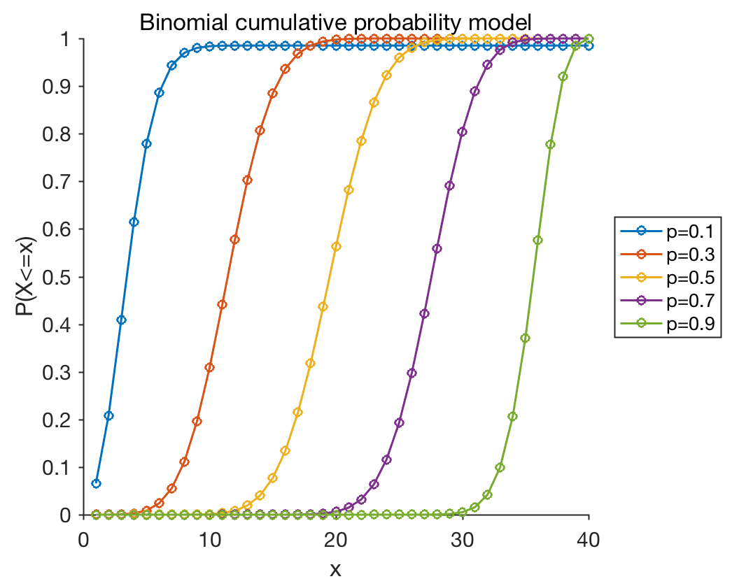
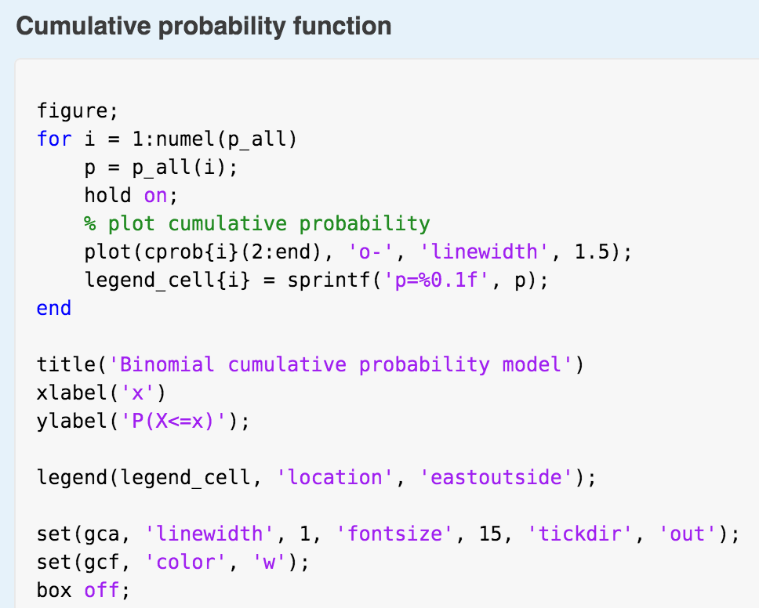
Lecture 12
Binomial model
Cumulative probability density function
CHOONG-WAN WOO | COCOAN lab | http://cocoanlab.github.io

Slide 19
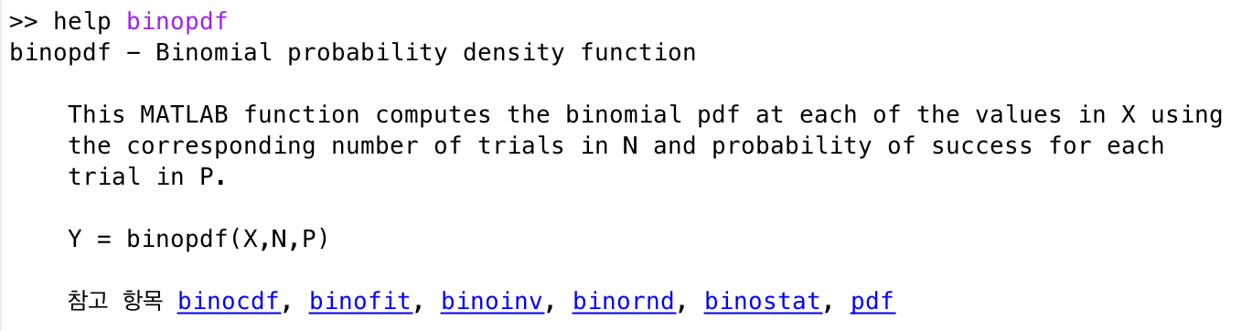
Lecture 12
Binomial model
binopdf.m and binocdf.m in MATLAB
binom in scipy
CHOONG-WAN WOO | COCOAN lab | http://cocoanlab.github.io

Slide 20
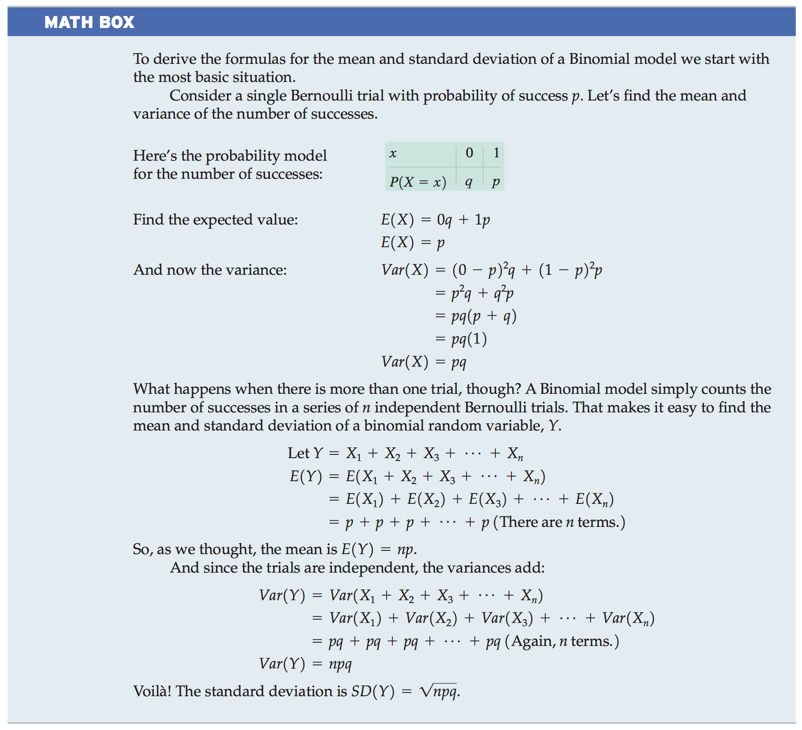
Lecture 12
Binomial model
CHOONG-WAN WOO | COCOAN lab | http://cocoanlab.github.io

Slide 21
Lecture 12
Binomial model
CHOONG-WAN WOO | COCOAN lab | http://cocoanlab.github.io

Slide 22
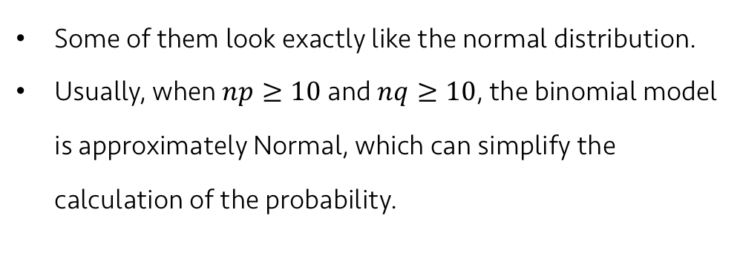
Lecture 12
Approximating the binomial with a normal model
Plot for Binom(n, p), where n = 40
Some of them look exactly like the normal distribution.
Usually, when $np≥10$and $nq≥10$, the binomial model is approximately Normal, which can simplify the calculation of the probability.
CHOONG-WAN WOO | COCOAN lab | http://cocoanlab.github.io

Slide 23
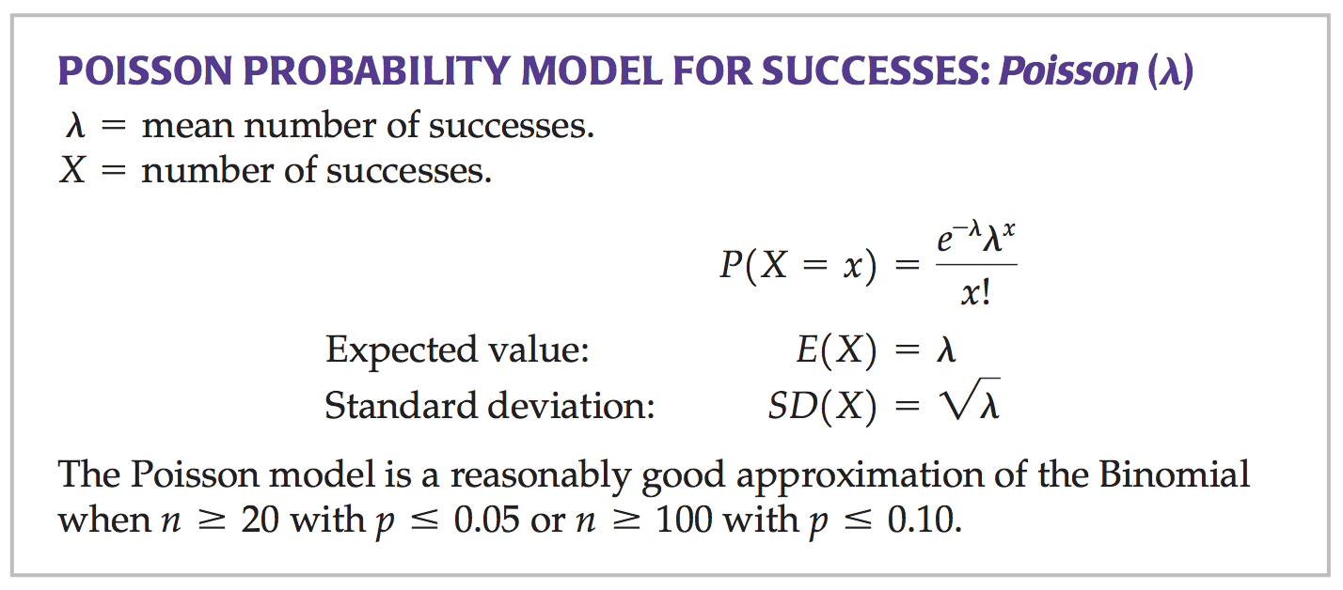
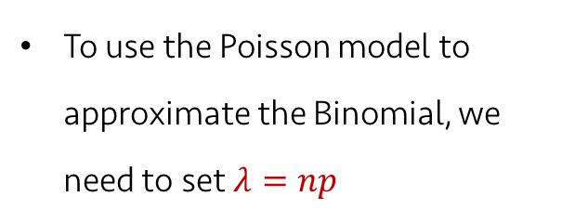
Lecture 12
The Poisson model
When rare events occur together or in clusters, people often want to know if that happened just by chance or whether something else is going on.
Binomial probability could be difficult to calculate in when n is too big (you should calculate n!, for example).
Simeon Denis Poisson (French mathematician) derived his model to approximate the Binomial model when the probability of a success, p, is very small and the number of trials, n, is very large.
To use the Poisson model to approximate the Binomial, we need to set $λ=np$
CHOONG-WAN WOO | COCOAN lab | http://cocoanlab.github.io

Slide 24
Lecture 12
Quiz 12-3 (3 min)
https://forms.gle/FEpU3SEVrCJWj93H9
CHOONG-WAN WOO | COCOAN lab | http://cocoanlab.github.io

Slide 25
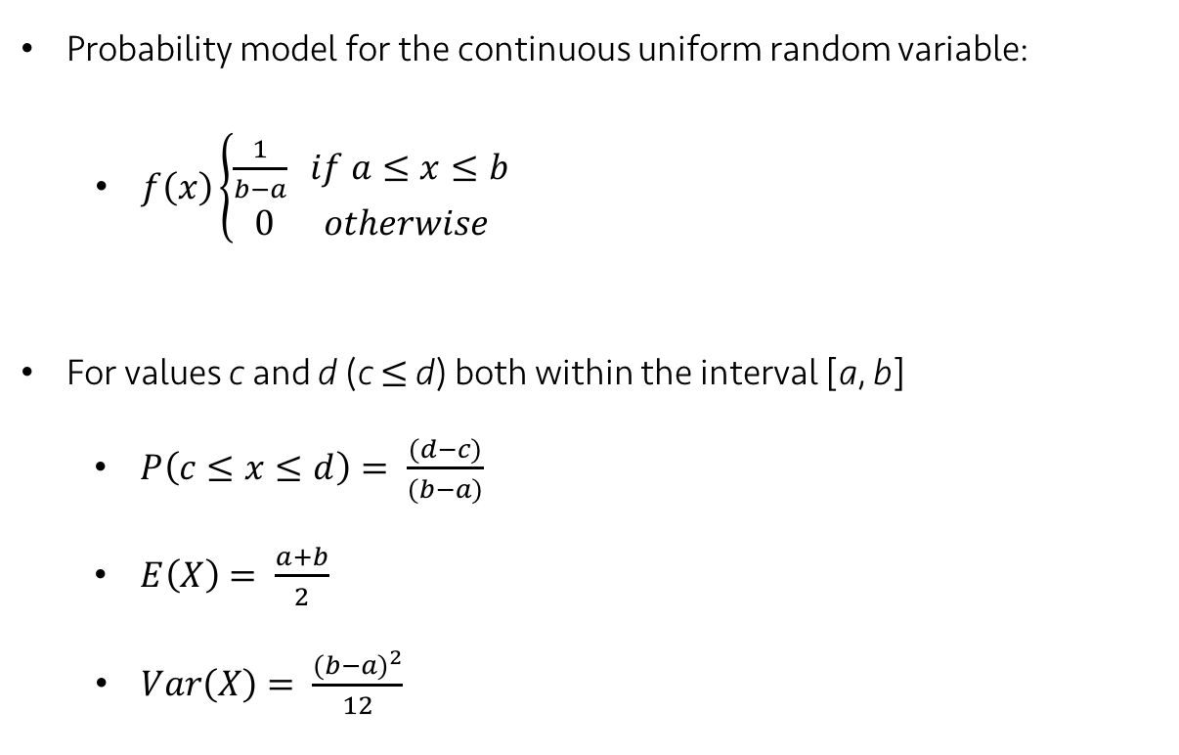
Lecture 12
The Uniform Model
Probability model for the continuous uniform random variable:
$f\left(x\right)\left\{\begin{aligned}\frac{1}{b−a} if a≤x≤b \\ 0 otherwise\end{aligned}\right.$
For values c and d (c $≤$ d) both within the interval [a, b]
$P\left(c≤x≤d\right)= \frac{(d−c)}{(b−a)}$
$E\left(X\right)= \frac{a+b}{2}$
$Var\left(X\right)= \frac{{(b−a)}^{2}}{12}$
CHOONG-WAN WOO | COCOAN lab | http://cocoanlab.github.io

Slide 26
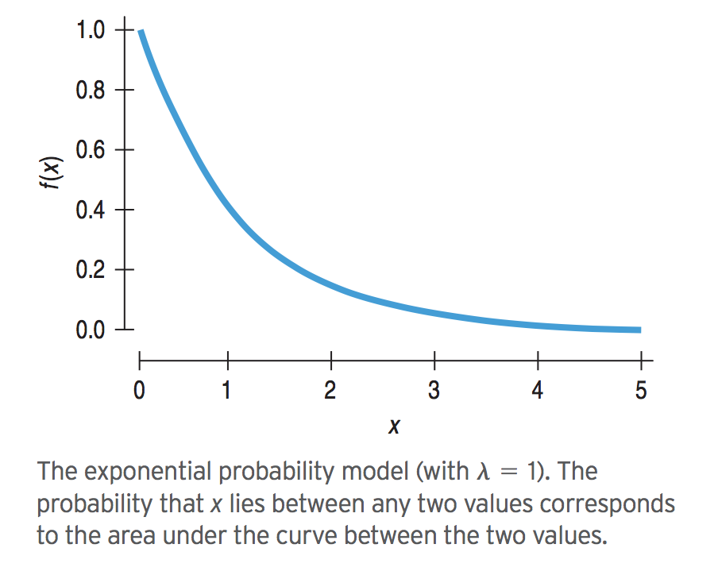
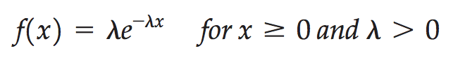
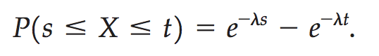
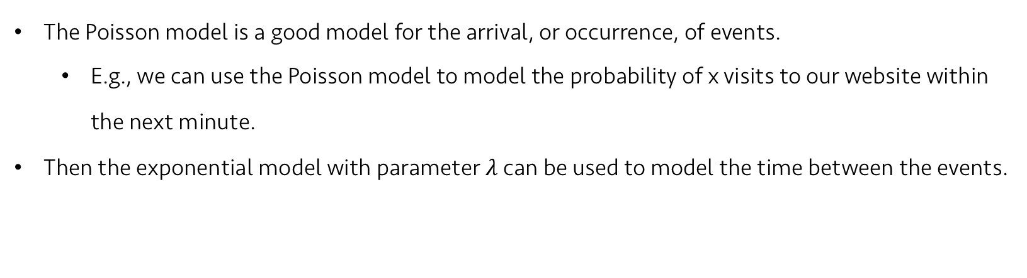
Lecture 12
The Exponential Model
The Poisson model is a good model for the arrival, or occurrence, of events.
E.g., we can use the Poisson model to model the probability of x visits to our website within the next minute.
Then the exponential model with parameter $λ$ can be used to model the time between the events.
Mean and standard deviation of the exponential is $1/λ$
CHOONG-WAN WOO | COCOAN lab | http://cocoanlab.github.io

Slide 27
Lecture 12
Quiz 12-4 (2 min)
https://forms.gle/vwz7VDVAFL8egxRG8
CHOONG-WAN WOO | COCOAN lab | http://cocoanlab.github.io

Slide 28
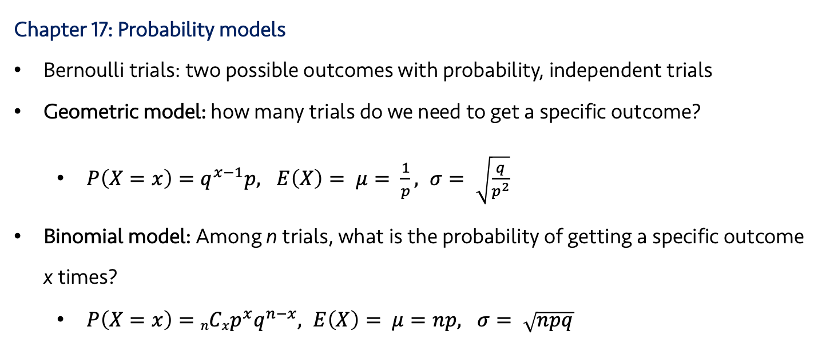
Lecture 12
Key Points I
Chapter 17: Probability models
Bernoulli trials: two possible outcomes with probability, independent trials
Geometric model: how many trials do we need to get a specific outcome?
$P\left(X=x\right)=q^{x−1}p, E\left(X\right)= μ= \frac{1}{p}, σ= \sqrt{\frac{q}{p^{2}}}$
Binomial model: Among n trials, what is the probability of getting a specific outcome x times?
$P\left(X=x\right)=nCxp^{x}q^{n−x}, E\left(X\right)= μ=np, σ= \sqrt{npq}$
CHOONG-WAN WOO | COCOAN lab | http://cocoanlab.github.io

Slide 29
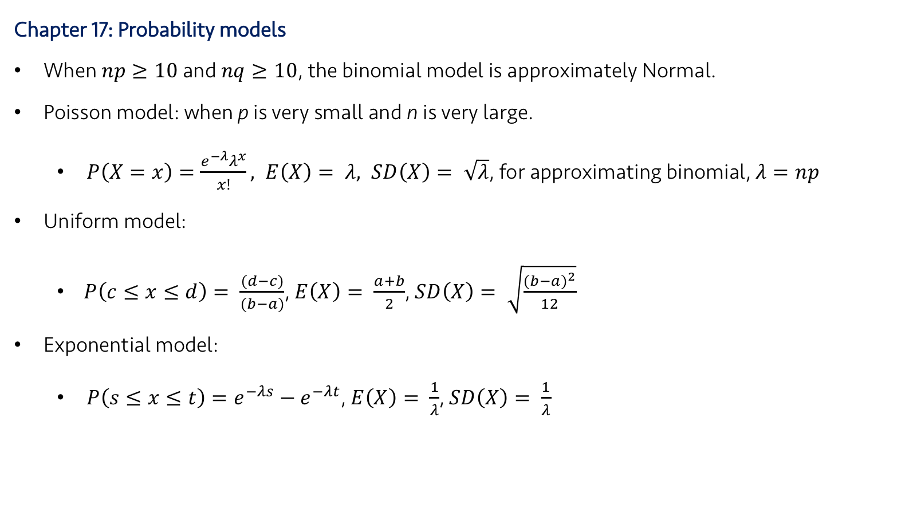
Lecture 11 | 101718
Key Points II
Chapter 17: Probability models
When $np≥10$and $nq≥10$, the binomial model is approximately Normal.
Poisson model: when p is very small and n is very large.
$P\left(X=x\right)=\frac{e^{−λ}λ^{x}}{x!}, E\left(X\right)= λ, SD\left(X\right)= \sqrt{λ}$, for approximating binomial, $λ=np$
Uniform model:
$P\left(c≤x≤d\right)= \frac{(d−c)}{(b−a)}$, $E\left(X\right)= \frac{a+b}{2}$, $SD\left(X\right)= \sqrt{\frac{{(b−a)}^{2}}{12}}$
Exponential model:
$P\left(s≤x≤t\right)=e^{−λs}−e^{−λt}$, $E\left(X\right)= \frac{1}{λ}$, $SD\left(X\right)= \frac{1}{λ}$
CHOONG-WAN WOO | COCOAN lab | http://cocoanlab.github.io

